Slide 1
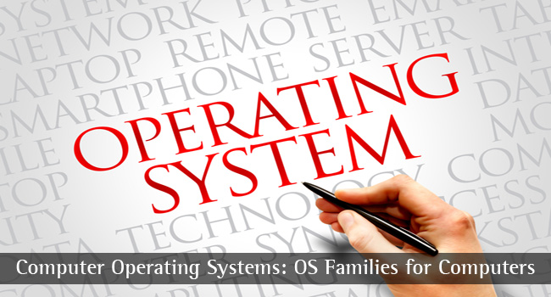
CS-3103 : Operating Systems : Sec-A (NB) : Introduction
CSEN3103-BTech-Sec A

Slide 2
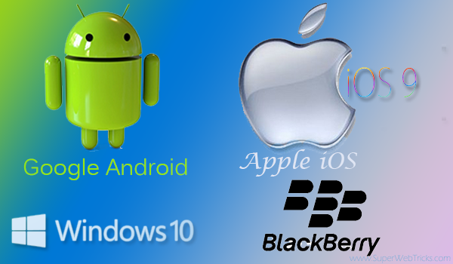
Set of Operating Systems Running…..
CSEN3103-BTech-Sec A

Slide 3

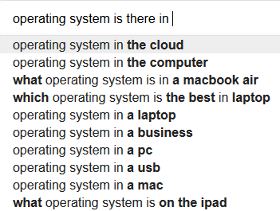

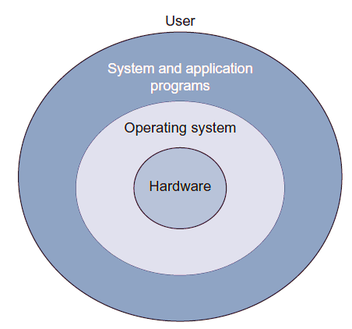
What is an OS we carry with us every day (may be 24/7) ?
Presents an environment for the user so that he or she can easily work without worrying about the hardware resources.
Manages all the resources in an efficient manner.
CSEN3103-BTech-Sec A

Slide 4
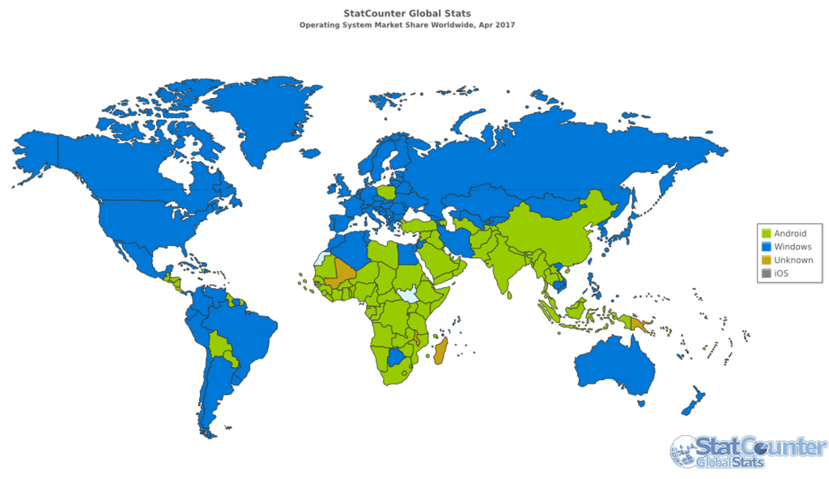
CSEN3103-BTech-Sec A

Slide 5
What is an OS we carry with us every day (may be 24/7) ?
When a computer is turned on, the operating system (OS) is loaded into its main memory and it takes control of the system.
It provides an interface to the user for interaction.
The user does not work with the actual machine but with a virtual machine that is offered by the OS.
Set of programs that acts as an interface between the user and the machine.
It manages and allocates the resources available in the computer system, thus, OS can be considered as a resource manager.
Examples: Windows, Mac OS, Unix,
Linux, etc.
CSEN3103-BTech-Sec A

Slide 6
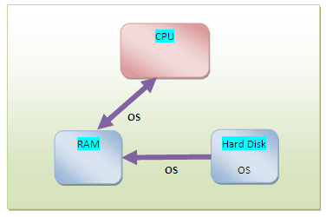
Objectives of an Operating System?
User-friendly
Interprets commands
Creates an environment for other programs to execute on the CPU
Allocates resources to the executing program as and when required
Harnesses the full power of the machine
CSEN3103-BTech-Sec A

Slide 7
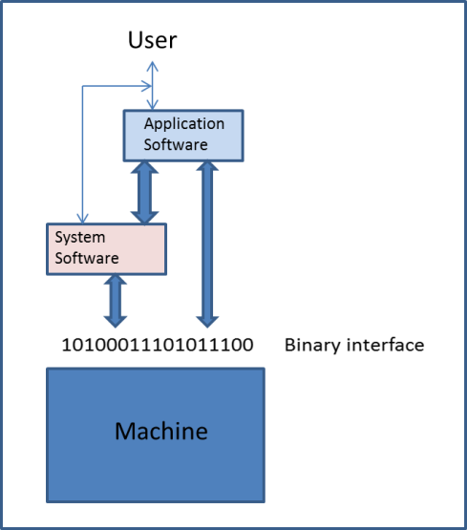
Computer System Components : Categories of Software
Software can be divided into two major categories:
  Application software
  System software
CSEN3103-BTech-Sec A

Slide 8
Application Software
Application software is bought by the user and loaded on the computer system to satisfy the user’s application needs.
Example: An engineer might buy applications like python, netbeans, eclipse, oracle, codeblocks, MS-office, winzip et. al.
System Software
This is a layer between application software and the machine.
It provides services and resources to application software at one end and harnesses the power of the machine at the other end.
Examples: Operating system, compilers, interpreters, assemblers, etc.
CSEN3103-BTech-Sec A

Slide 9
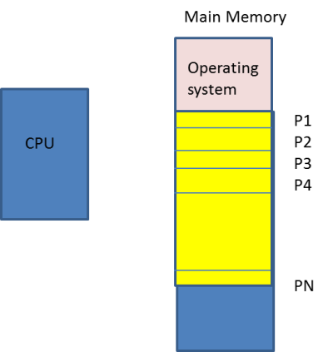
Little bit idea of some keywords we would use in this subject….
Any executable program must get space in memory before it is executed, instruction by instruction, by CPU. The OS loads the program into main memory (MM) and dispatches it to the CPU for execution. OS also provides other resources, like, CPU time, memory space, files, input-output devices, interrupts can be considered as instances of resources…..
Execution of programs (p₁..p_{n}) one-at-a-time with several CPU scheduling algos., Round Robin with time slicing
CSEN3103-BTech-Sec A

Slide 10
What is an Operating System….
1.What is operating system?
a) collection of programs that manages hardware resources
b) system service provider to the application programs
c) link to interface the hardware and application programs
d) all of the mentioned
Ans : (d)
2. Which one of the following error will be handled by the operating system?
a) power failure
b) lack of paper in printer
c) connection failure in the network
d) all of the mentioned
Answer: d
CSEN3103-BTech-Sec A

Slide 11
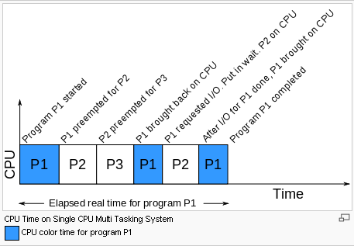
CPU scheduling
CSEN3103-BTech-Sec A

Slide 12
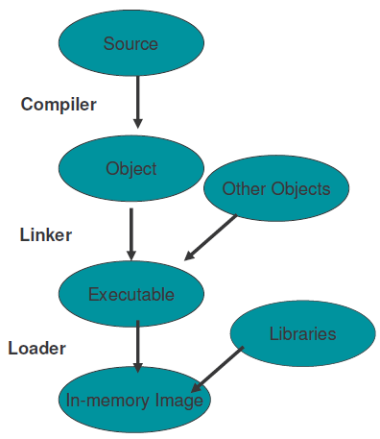
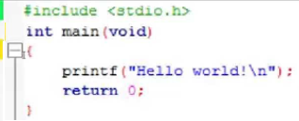
@myhome$ gcc –o hello helloworld.c
@myhome$ ./hello
CSEN3103-BTech-Sec A

Slide 13
Division of Labor: Kernel and Shell
There are two agencies: the kernel and shell
The kernel interacts with the machine’s hardware, and the shell with the user.
The kernel is the core of the operating system-a collection of routines mostly written in C.
Kernel is loaded into memory when the system is booted and communicates directly with the hardware.
User programs (the applications) that need to access the hardware (like the hard disk or terminal) use the services of the kernel that performs the job on the user.
CSEN3103-BTech-Sec A

Slide 14
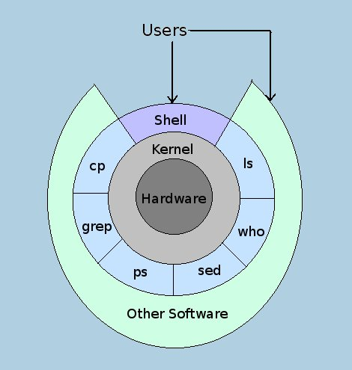
The Kernel-Shell Relationship
CSEN3103-BTech-Sec A

Slide 15
SOME POPULAR COMMANDS …..
ps: process status. ps displays the processes owned by the user running the command.
$ps
PID TTY TIME CMD
291 console 0:00 bash // the login shell of this user
Ignore the header. Each line shows the PID (process ID, unique per process), the terminal (TTY) with which the process is associated (the controlling terminal), the cumulative processor time (TIME) that has been consumed since the process has been started (CPU usage is negligible), and the process name (CMD: user is running the bash shell, our shell can be different).
cp (copying a file): This command copies a file or a group of files. It creates an exact image of the file on disk with a different name.
$cp csen3103 csen3113
CSEN3103-BTech-Sec A

Slide 16
SOME POPULAR COMMANDS …..
cp (copying a file): If the destination file (csen3113) doesn’t exist, it will first be created before copying takes place.
$cp csen3103 seca/csen3113 // csen3103 copied to csen3113 under seca directory
$cp csen3103 seca // csen3103 retains its name under seca
grep: filters using regular expressions, grep, that is used to search a file for a pattern and display the lines containing the pattern.
$grep “sales” emp.lst
2233| a.k. shukla | g.m. |sales |12/12/15 |6000
1006| r. das | manager |sales |03/09/14 |6700
1006| s.n. dasgupta | manager |sales |26/10/14 |7700
sed: the stream editor. Example: Line addressing
$sed ‘2q’ emp.lst
CSEN3103-BTech-Sec A

Slide 17
SOME POPULAR COMMANDS …..
$sed ‘2q’ emp.lst // Quits after line number 2
2233| a.k. shukla | g.m. |sales |12/12/15 |6000
1006| r. das | manager |sales |03/09/14 |6700
who: who are the users?
$who
$who –Hu // H→Header; u → list of users
$who am i
ls: Listing directory contents
ls, ls –l, ls –al etc.
CSEN3103-BTech-Sec A

Slide 18
More about Kernel…
Providing support to User Programs is one job of Kernel.
The kernel has a great deal of housekeeping, like, managing System’s memory, scheduling processes, deciding the priority of processes.
The Kernel is often called the operating system – a program’s gateway to the computer’s resources.
CSEN3103-BTech-Sec A

Slide 19
The File and Process
Two simple entities support the UNIX system – the file and process.
Files have places and processes have life.
A file is just an array of bytes and can contain virtually anything.
UNIX doesn’t really care to know the type of file you are using.
It considers even directories and devices as members of the file system.
The dominant file type is text, and the behavior of the system is mainly controlled by text files.
CSEN3103-BTech-Sec A

Slide 20
Phases of Evolution of Operating Systems
Single user system
Multiuser system
Multiprogramming
Multitasking
Single user multitasking
Batch processing
Multiprocessing
Parallel processing
Network operating system

Slide 21
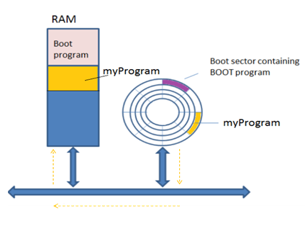
Single user system
The OS takes control of the computer. On a user request, it loads a program from the hard disk into main memory.
Program loaded into main memory
CSEN3103-BTech-Sec A

Slide 22

Disadvantages of Single User System
After completion of a job, the loading of a new program requires an I/O operation from secondary storage devices.
If the currently executing program asks for an I/O operation, the CPU has to wait till the I/O device provides the required service to the program.
CSEN3103-BTech-Sec A

Slide 23
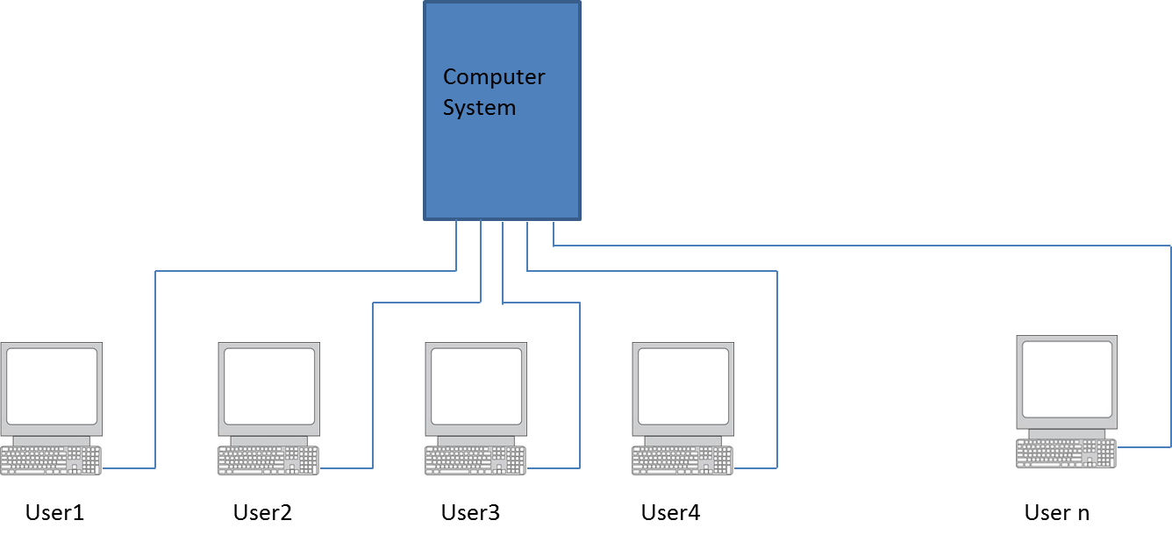
Multi-user System
In order to overcome the disadvantages of single user operating systems, computers were designed that they could support multiple users.
CSEN3103-BTech-Sec A

Slide 24
Multi-user to Multi-programmed Systems
If the currently executing program asks for an I/O operation, the OS suspends execution of the program and dispatches another program to the CPU for execution. Thus, the CPU never remains idle. The simultaneous residency of multiple programs in the main memory is called multiprogramming.
CSEN3103-BTech-Sec A

Slide 25
Objectives: Multiprogramming system is inherently a multi-user system
Goal of multi programming: Maximum utilisation of CPU time
Efficient management of main memory
To achieve the above objectives, we need to answer the following questions:
  Which program should be brought into main memory?
  Of the resident programs, which one should be executed next?
The ability of an operating system to accept more than one job from a single user is called multitasking.
CSEN3103-BTech-Sec A

Slide 26
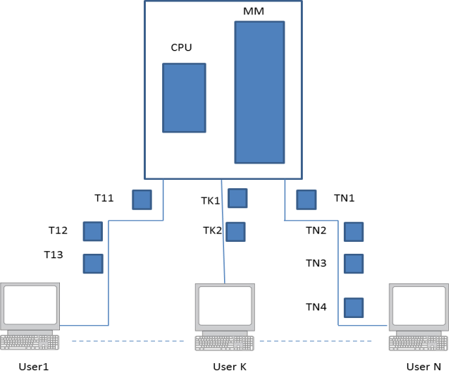
Multitasking System
Task: The user or system job that needs to be performed.
The ability of an operating system to accept more than one job from a single user is called multitasking.
Example: UNIX is a multi-user, multiprogramming and multitasking operating system.
CSEN3103-BTech-Sec A

Slide 27
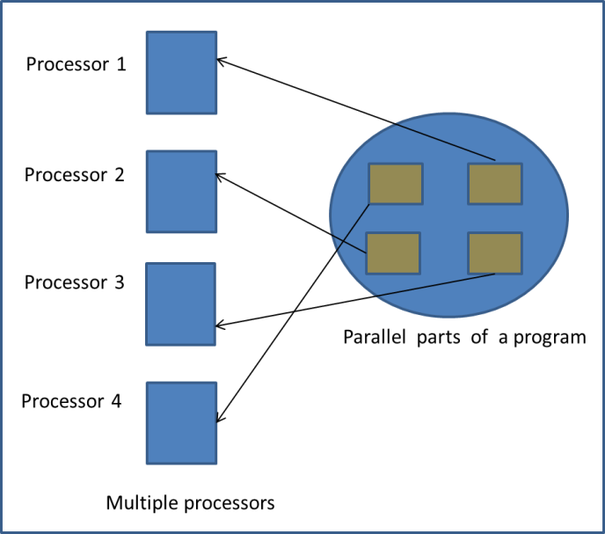
Parallel Processing
There are some algorithms which are inherently parallel in nature. Example, we have quick sort and merge sort dividing the data into partitions that can be processed independently of each other, provided a sufficiently number of processors are available in the computer system.
CSEN3103-BTech-Sec A

Slide 28
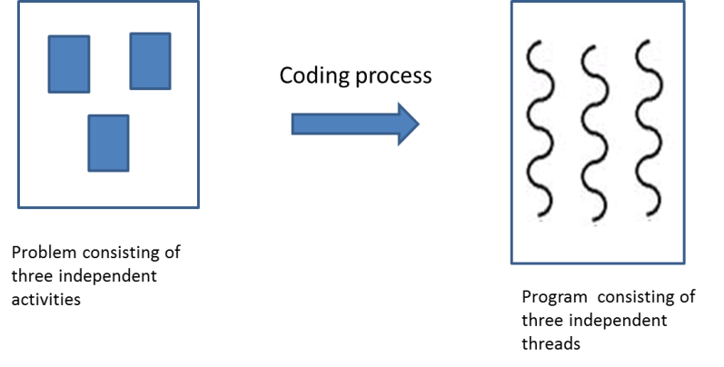
Multithreading operating system
A thread can be precisely defined as a separate path of execution through the code of a program. The operating system that can handle multiple threads of a program is called a multithreading operating system.
CSEN3103-BTech-Sec A

Slide 29
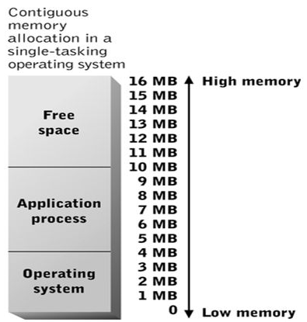
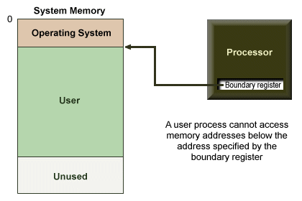
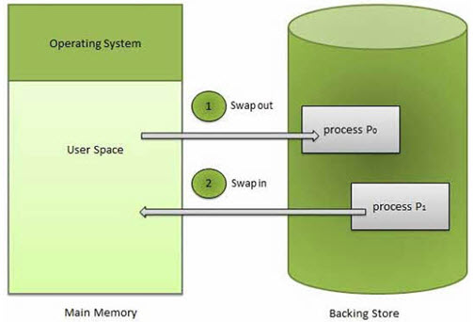
OS - MEMORY MANAGEMENT
CSEN3103-BTech-Sec A

Slide 30
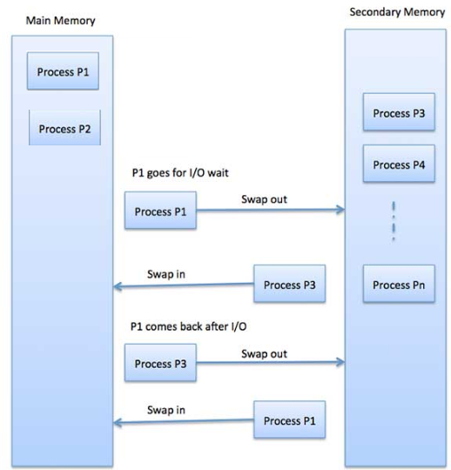
OS - MEMORY MANAGEMENT…
CSEN3103-BTech-Sec A

Slide 31
Real-Time Systems
Often used as a control device in a dedicated application such as controlling scientific experiments, medical imaging systems, industrial control systems, and some display systems.
Well-defined fixed-time constraints.
Hard real-time system.
  Secondary storage limited or absent, data stored in short-term memory, or read-only memory (ROM)
  Conflicts with time-sharing systems, not supported by general-purpose operating systems.
Soft real-time system
  Limited utility in industrial control or robotics
  Useful in applications (multimedia, virtual reality) requiring advanced operating-system features.
CSEN3103-BTech-Sec A

Slide 32
Distributed Systems
Distribute the computation among several physical processors.
Loosely coupled system – each processor has its own local memory; processors communicate with one another through various communications lines, such as high-speed buses or telephone lines.
Advantages of distributed systems.
  Resources Sharing
  Computation speed up – load sharing
  Reliability
  Communications
CSEN3103-BTech-Sec A

Slide 33
Distributed Systems (Cont.)
Network Operating System
  provides file sharing
  provides communication scheme
  runs independently from other computers on the network
Distributed Operating System
  less autonomy between computers
  gives the impression there is a single operating system controlling the network.
CSEN3103-BTech-Sec A

Slide 34
Some info. that may be handy…..
Windows, OS X of Apple and Unix are multithreading operating systems.
A network operating system (NOS) can be define as an operating system that manages resources distributed over a computer network and enables communication across the network. Ex: Novell NetWare 2.5, Windows NT Server and Mac OS AppleShare are network operating system.
Real time operating systems (RTOS) have the following attributes: 1) Fault tolerance; 2) Deterministic scheduling; There may be jobs such as flight control, telephone switching, missile control etc., require a response to events within a certain amount of time. These time sensitive jobs are called real-time jobs or processes. RTOS provides services to these processes. Job scheduling is the most important activity of RTOS, i.e., deciding which one of the available jobs will run next so that the impending deadlines are met.

Slide 35
Functions of Operating Systems ➔ what’s coming up……
Process management (processes, threads, cpu scheduling, process synchronization, mutual exclusion, deadlock, semaphores, monitors…..)
Memory management (MM + VM)
Processor management (keywords given… concurrency control….)
Input/Output and file/disk management
Security
Operating Systems

